Slide 1
INTRO TO DISTRIBUTED SYSTEMS
Lecture-4

Slide 2
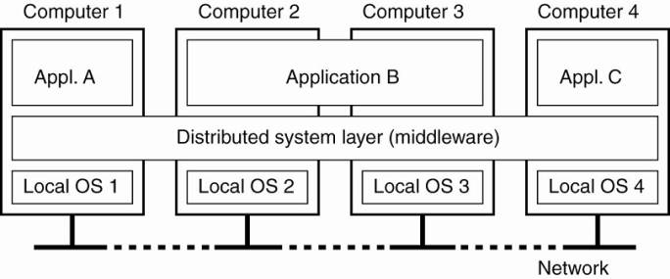
A Distributed System

Slide 3
Definition
A distributed system is
a collection of independent computers
that appears to its users as a single coherent system.

Slide 4
Important aspects
a distributed system consists of components (i.e., computers) that are autonomous
users (people or programs) think they are dealing with a single system
autonomous components need to collaborate

Slide 5
Characteristics(1/2)
differences between various computers and the ways in which they communicate are mostly hidden from users
users and applications can interact with a distributed system in a consistent and uniform way, regardless of where and when interaction takes place.

Slide 6
Characteristics(2/2)
distributed systems should also be relatively easy to expand or scale.
a distributed system will normally be continuously available

Slide 7
Four Goals
should make resources easily accessible
should reasonably hide the fact that resources are distributed across a network;
should be open
should be scalable.

Slide 8
Making Resources Accessible
make it easy for the users (and applications) to access remote resources
to share them in a controlled and efficient way.

Slide 9
Distribution Transparency
hide the fact that
its processes and resources are physically distributed across multiple computers – systems should be transparent

Slide 10
Openness
offer services according to standard rules that describe the syntax and semantics of those services.
be easy to configure the system out of different components (possibly from different developers).
be easy to add new components or replace existing ones without affecting those components that stay in place.

Slide 11
Scalability
Can be measured with three matrices
Size - can easily add more users and resources to the system.
Geographic extent - a geographically scalable system is one in which the users and resources may lie far apart.
Administrative scalability - can be easy to manage even if it spans many independent administrative organizations.

Slide 12
Types of Distributed Systems
Distributed Computing Systems
Distributed Information Systems
Distributed Pervasive Systems

Slide 13
Distributed Computing Systems
Cluster computing -
Grid computing -

Slide 14
Cluster Computing
the underlying hardware consists of a
collection of similar workstations or PCs
closely connected by means of a high-speed local-area network,
each node runs the same operating system.

Slide 15
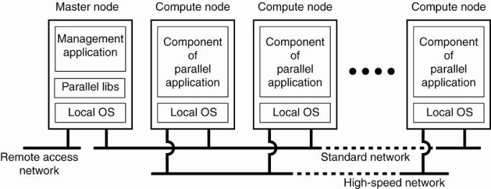
Cluster Computing System

Slide 16
Grid Computing
constructed as a federation of computer systems,
where each system may fall under a different administrative domain,
and may be very different when it comes to hardware, software, and deployed network technology.

Slide 17
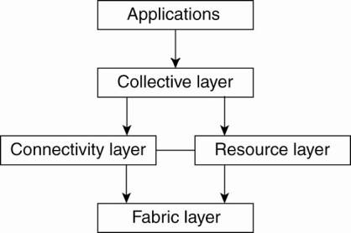
Grid Computing System

Slide 18
Distributed Information Systems
Transaction processing systems
Enterprise application integration (EAI)

Slide 19
Transaction Processing Systems
Focus on database applications
Programming using transactions
Ordinary statements, procedure calls, etc, are allowed inside a transaction.
Remote procedure calls (RPCs) procedure calls to remote servers

Slide 20
Properties of transactions (ACID)
Atomic
Consistent
Isolated
Durable

Slide 21
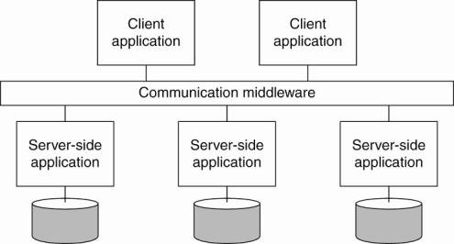
Enterprise Application Integration

Slide 22
Communication Middleware
Remote procedure calls (RPC)
Remote method invocations (RMI)
Problems with RPC and RMI:
The caller and callee both need to be up and running at the time of communication
They need to know exactly how to refer to each other
Results: Message-oriented middleware (MOM)

Slide 23
Distributed Pervasive Systems
is part of the surroundings -> inherently distributed.
general lack of human administrative control
devices can be configured by their owners
Examples:
Home Systems

Slide 24
Thank You

